Slide 1
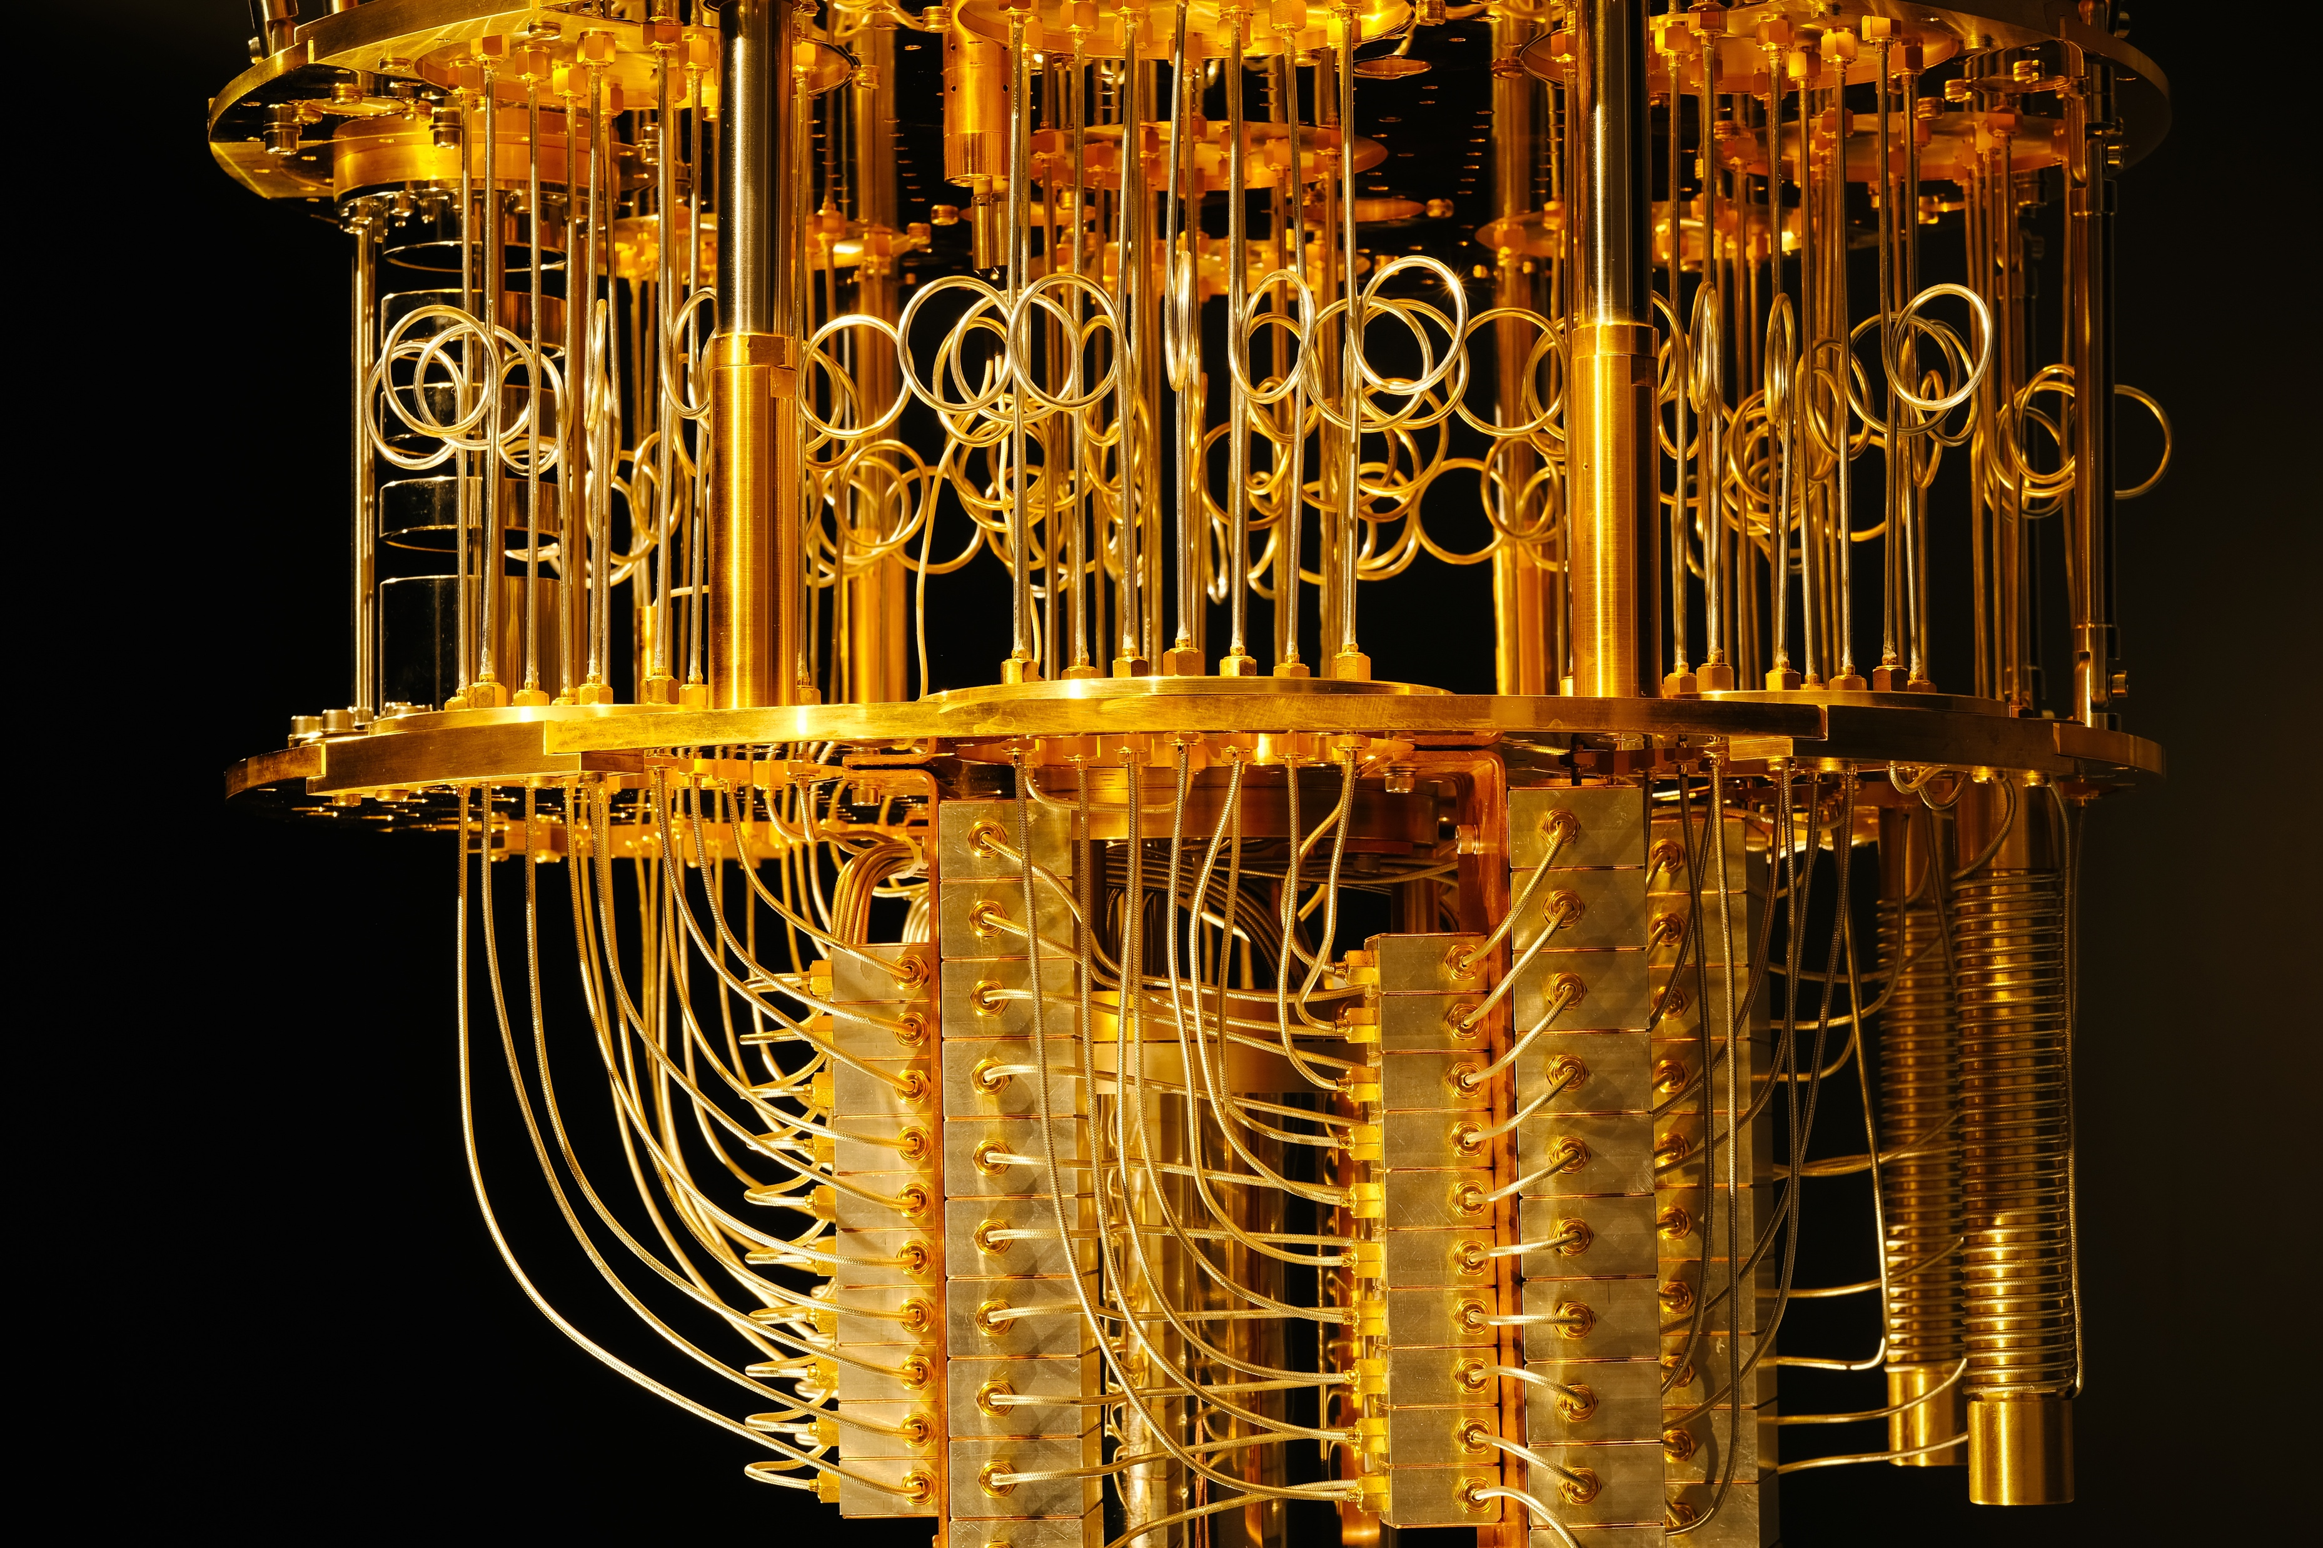


Quantum Computing with Qiskit — Luciano Bello IBM Research @microluciano @qiskit ibm.biz/qiskit-workshop quantum-computing.ibm.com research.ibm.com/ibm-q/ qiskit.org

Slide 2
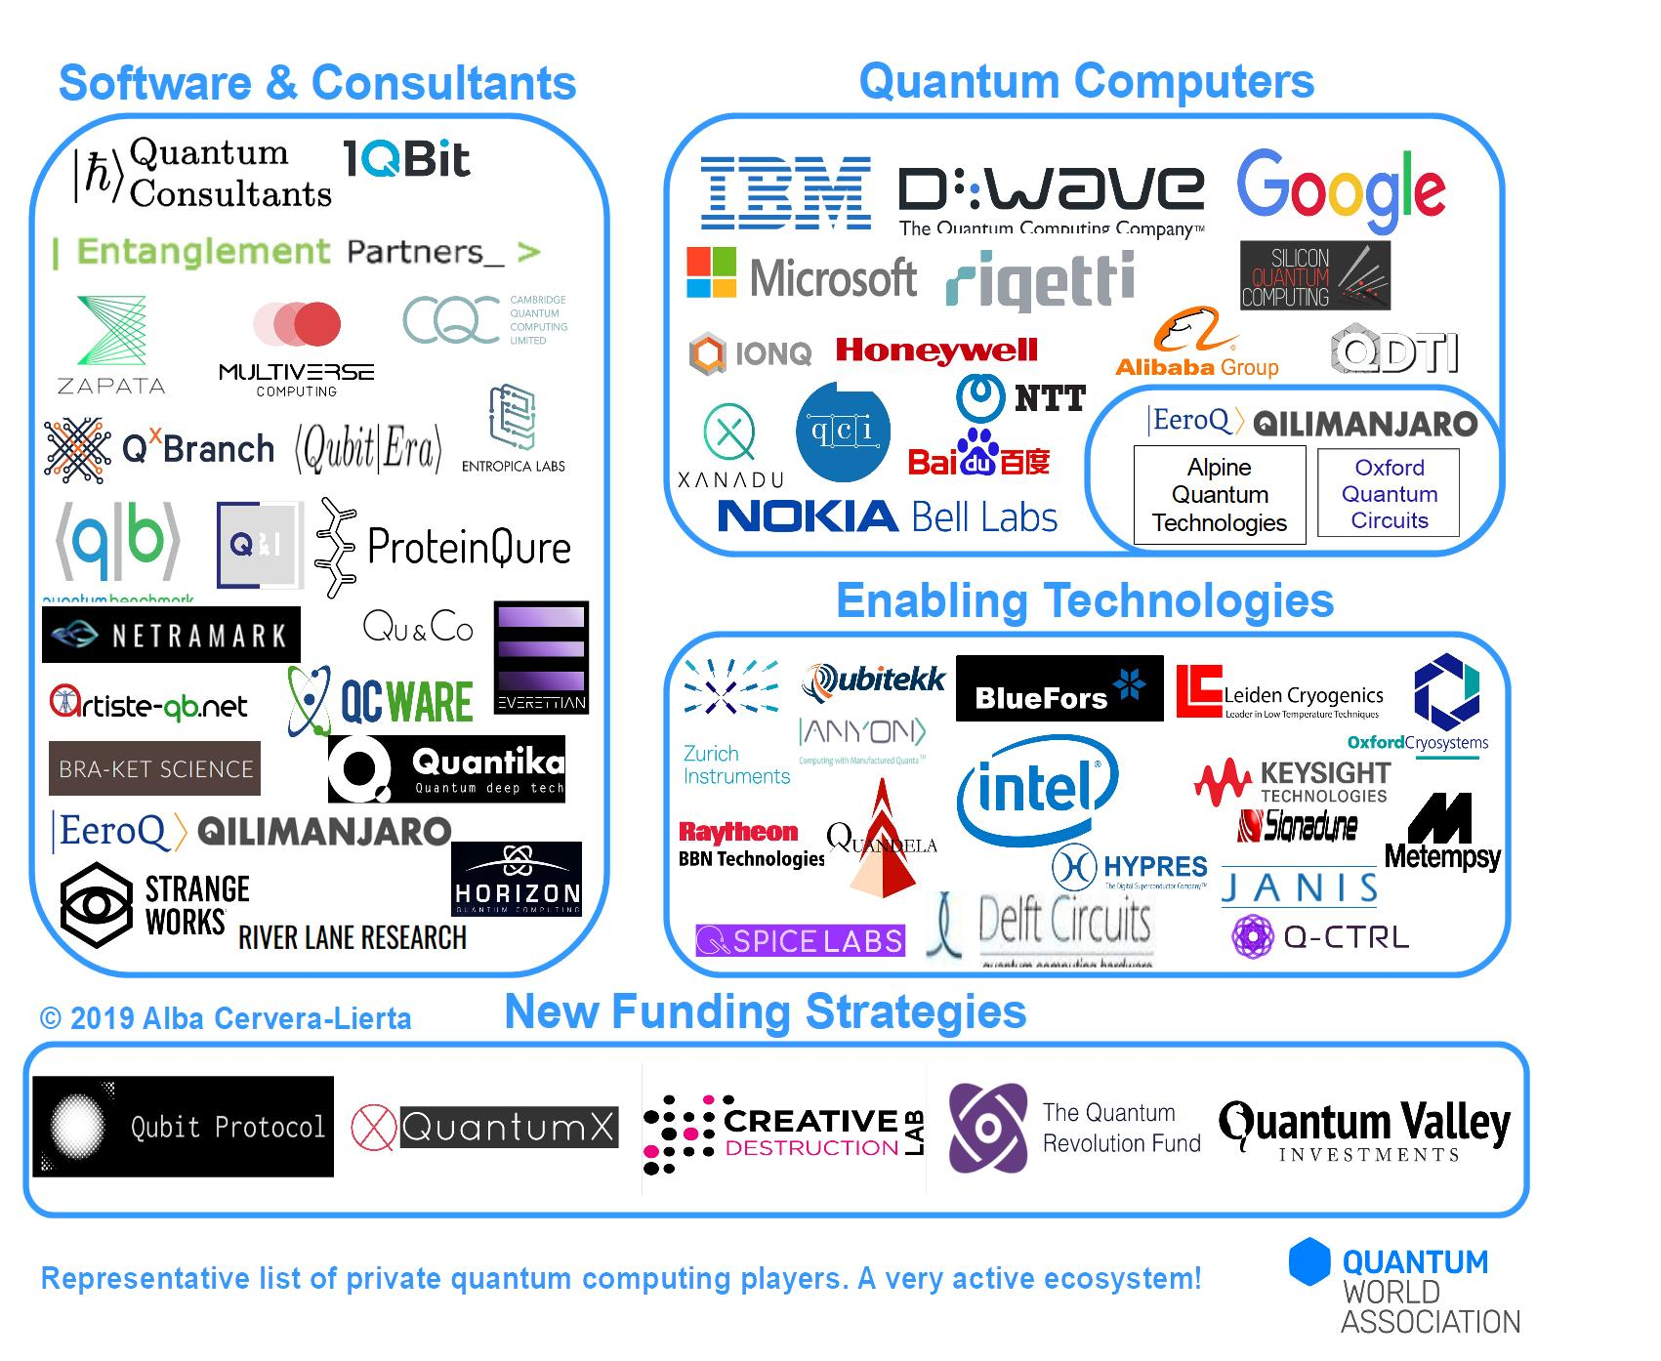
@albaclierta

Slide 3
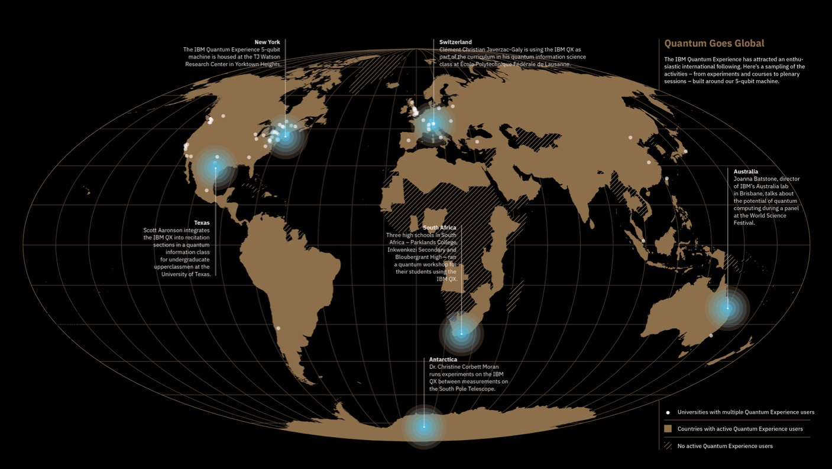

100K Unique Users
6 Million Experiments Run
130 Scientific Papers
Experience
ibm.biz/qiskit-workshop quantum-computing.ibm.com

Slide 4


From Bits to Qubits
1
0
|0⟩
X
|1⟩
0
1
|1⟩
X
|0⟩
0
1
1

Slide 5
From Bits to Qubits
0
1

Slide 6
From Bits to Qubits
|1⟩
|0⟩
|0⟩ + |1⟩

Slide 7
H
|1⟩
|0⟩
H
|0⟩ + |1⟩

Slide 8
H
|1⟩
|0⟩
H
|0⟩ - |1⟩

Slide 9
⨂
⨂

Slide 10
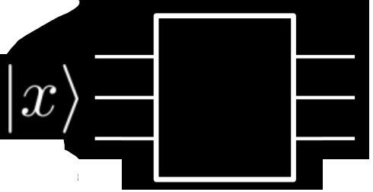
G
Quantum Computing with Qiskit #qiskit #IBMQ

Slide 11
The Deutsch’s problem
x |  | f₁(x) | f₂(x) | f₃(x) | f₄(x)
0 |  | 0 | 1 | 1 | 0
1 |  | 1 | 0 | 1 | 0
Is f(x) balanced or constant?
f(0) != f(1)
f(0) == f(1)

Slide 12
Is f(x) balanced or constant?
f(0) != f(1)
f(0) == f(1)

Slide 13
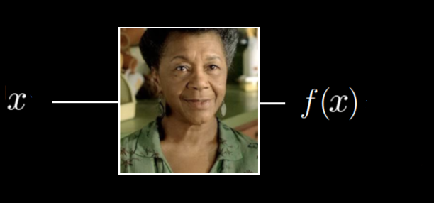
Is f(x) balanced or constant?
f(0) != f(1)
f(0) == f(1)

Slide 14
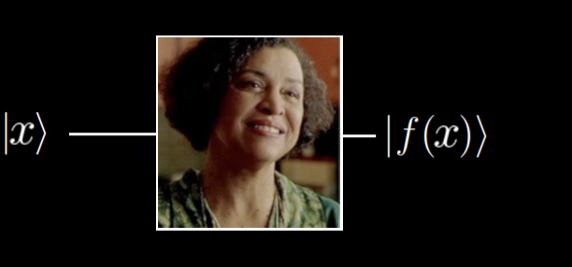
Is f(x) balanced or constant?
f(0) != f(1)
f(0) == f(1)

Slide 15
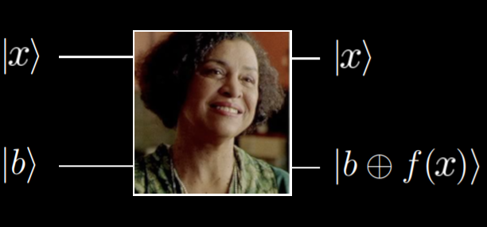
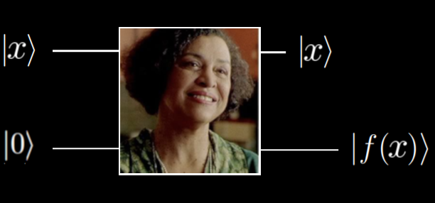

Slide 16
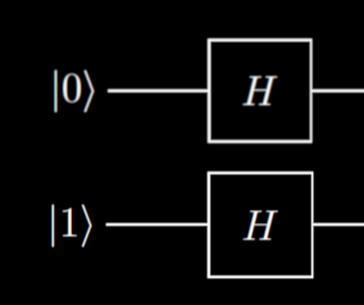
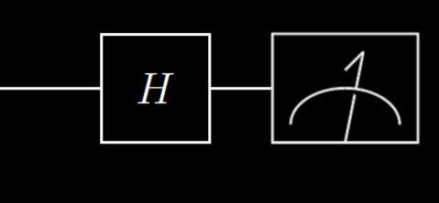
Why?
Read more in “Deutsch-Jozsa algorithm” section in https://quantum-computing.ibm.com/support/guides/quantum-algorithms-with-qiskit

Slide 17
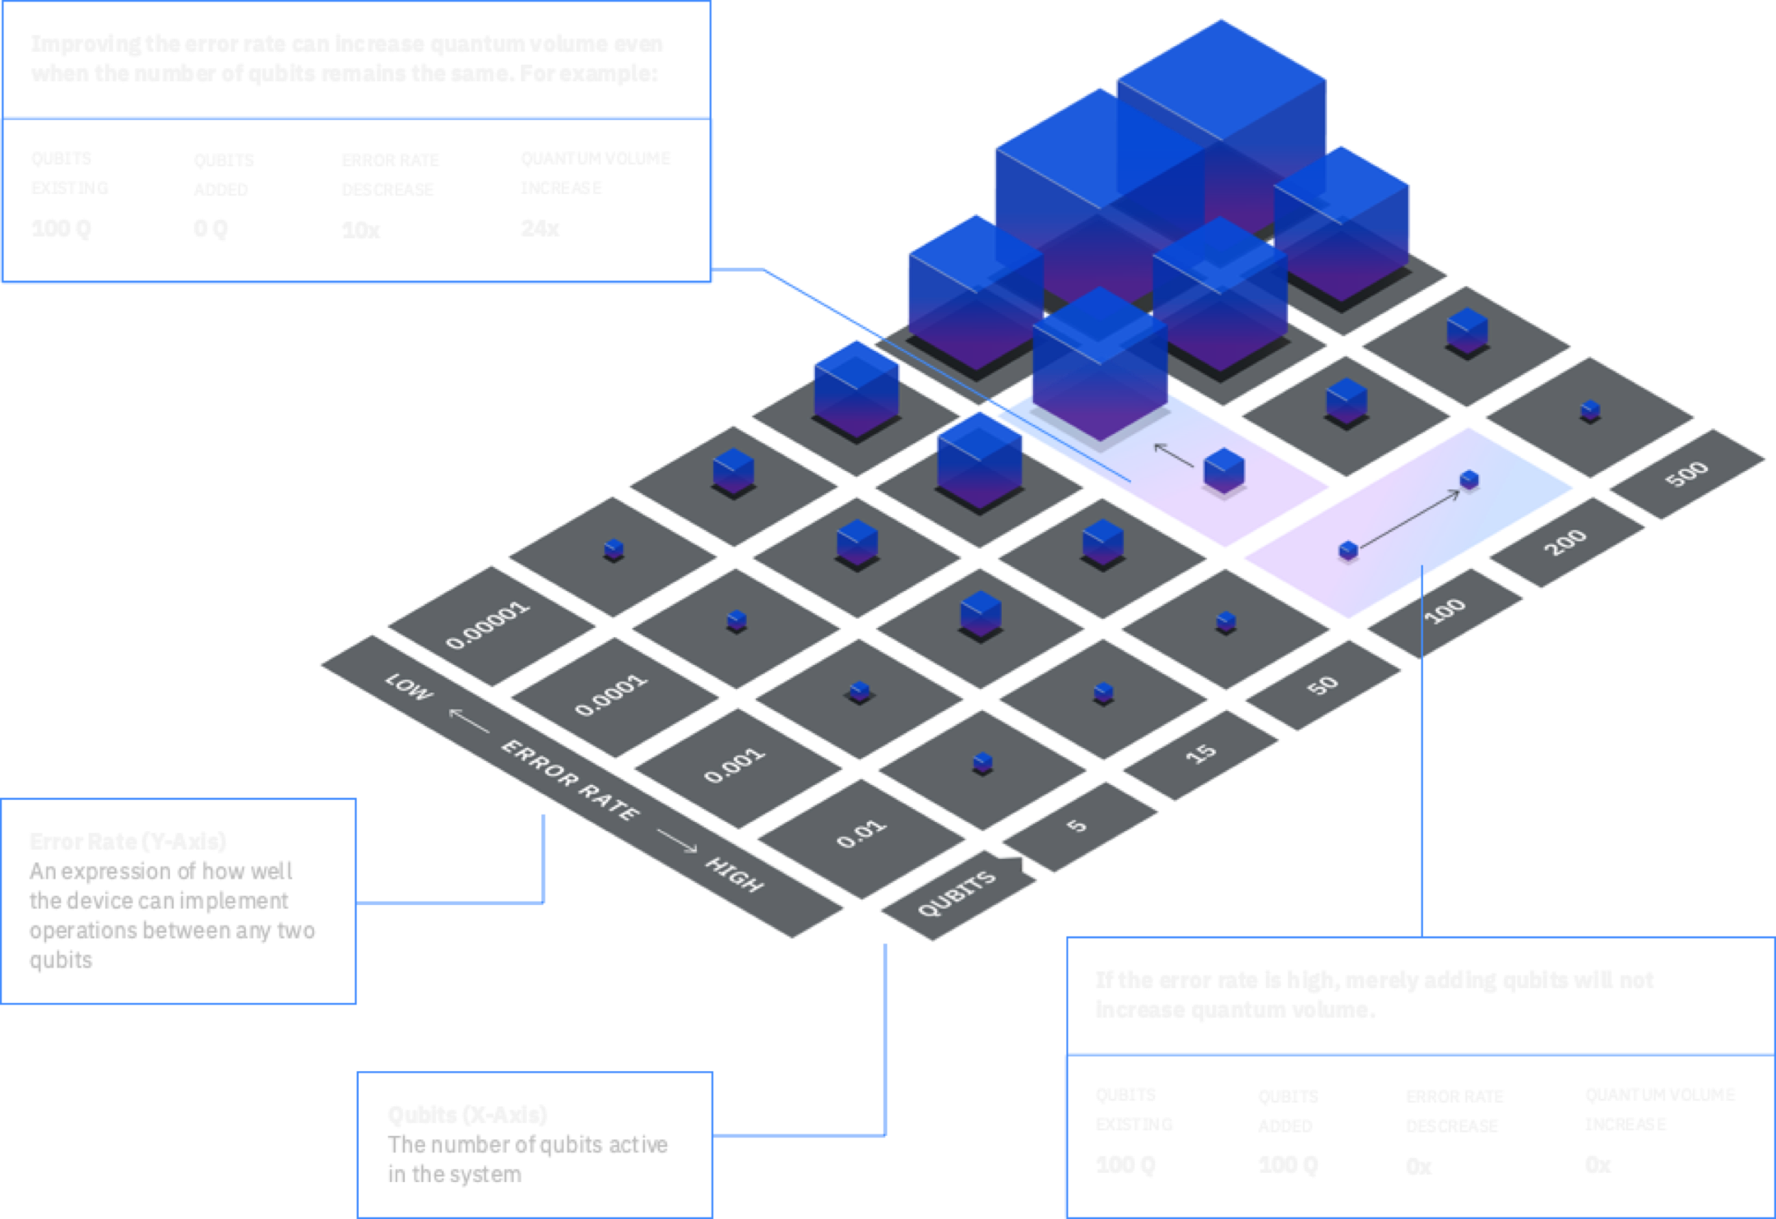

Slide 18
qiskit.org

Slide 19
Simulating quantum systems becomes intractable real quick.
Classical oracles can only be queried with a single number at a time. Quantum oracles can be queried in superposition.
We did not merely “try every answer simultaneously”. The problem had a structure that we could exploit using qubits.
There are still challenges (noise correction, decoherence, etc.), but you don’t need a lab to jump into quantum computing anymore.
Follow up with more algorithms and examples in qiskit.org

